Slide 1
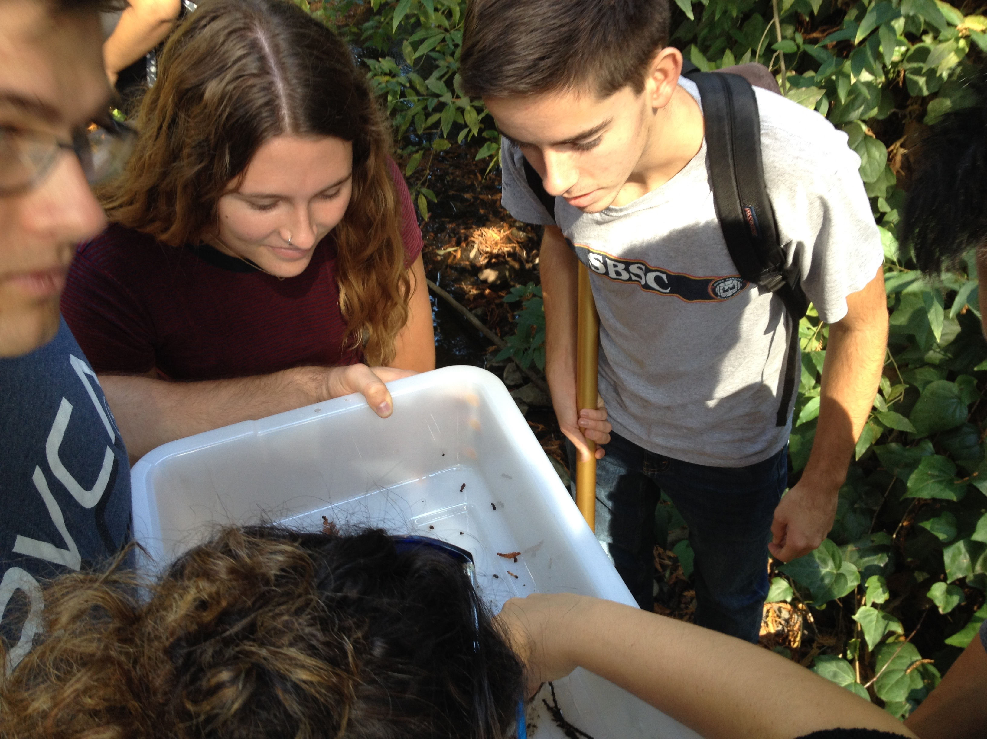
Environmental Science for Sustainability: Learning from Strawberry Creek and the Berkeley Campus (Landscape Arch 12)
G. Mathias Kondolf & Rachael Marzion
Dept of Landscape Architecture & Environmental Planning

Slide 2
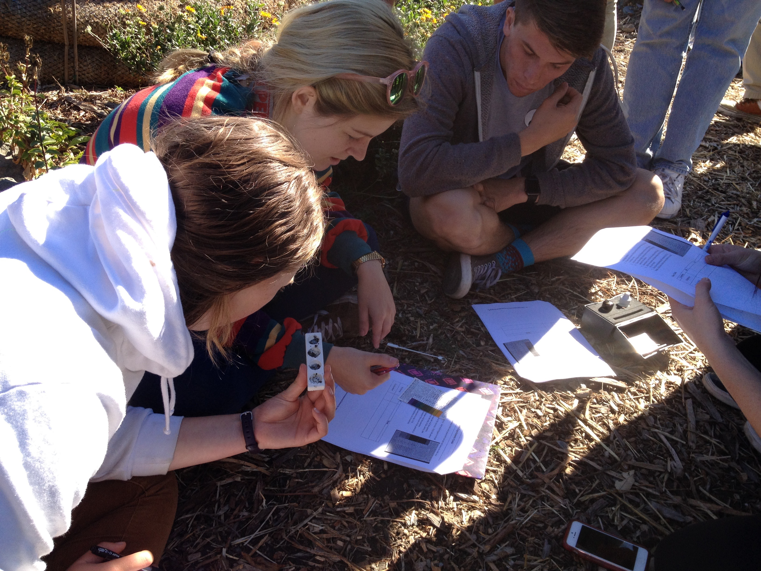
Understanding environmental science for sustainability: learning through direct measurement of local processes, ‘scaled up’ to their regional/global implications
Testing soil texture at the Student Organic Garden

Slide 3
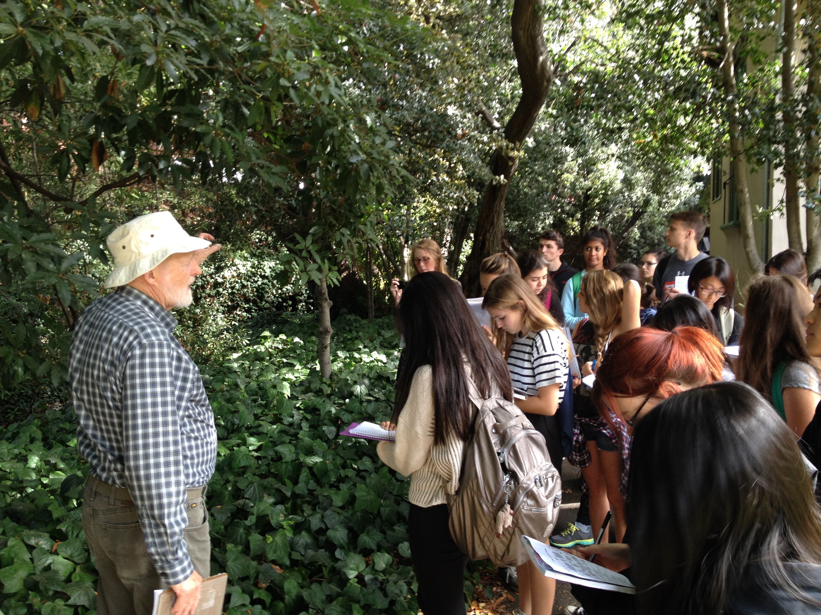
We developed field-based, hands-on exercises for on hydrology, riparian and aquatic ecology, water quality, urban forestry, air quality, and stormwater management.
Joe McBride points out native riparian trees along Strawberry Ck

Slide 4
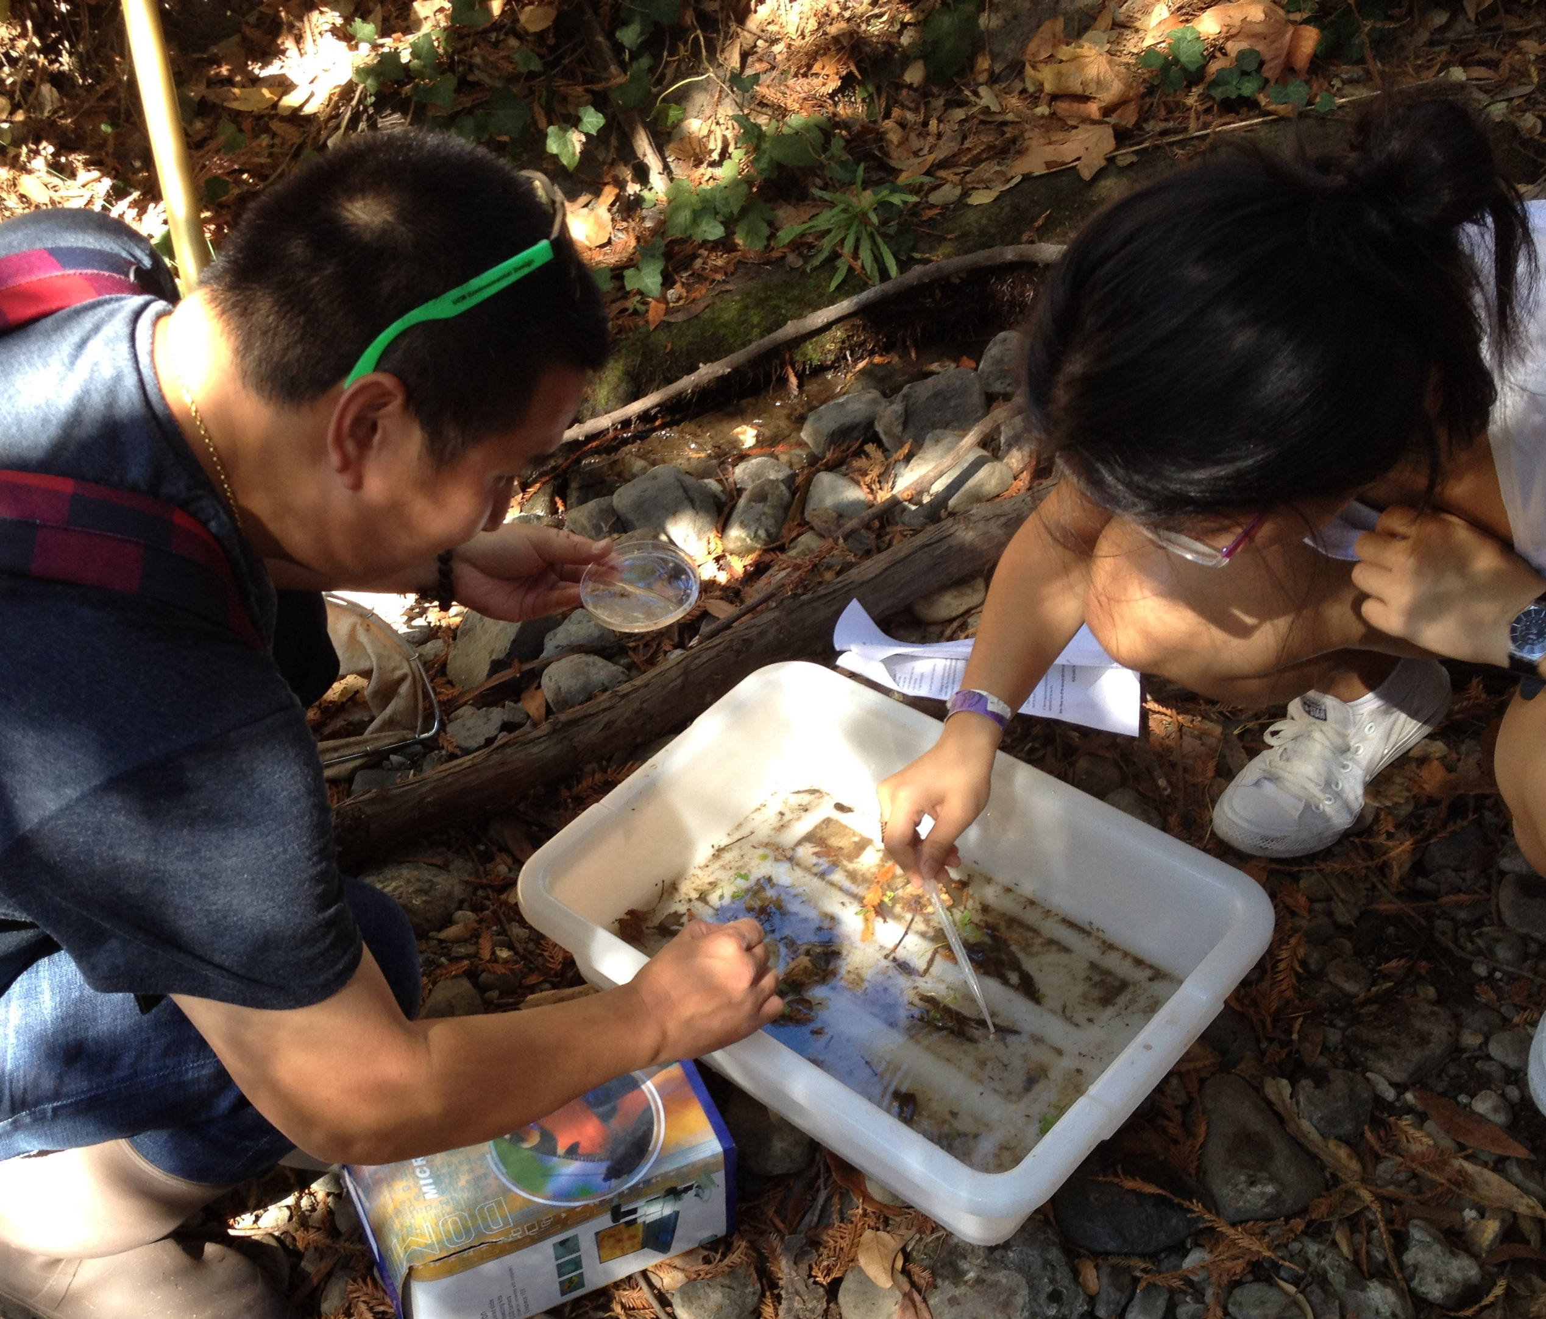
Macroinvertebrate sampling to assess water quality, Strawberry Ck

Slide 5
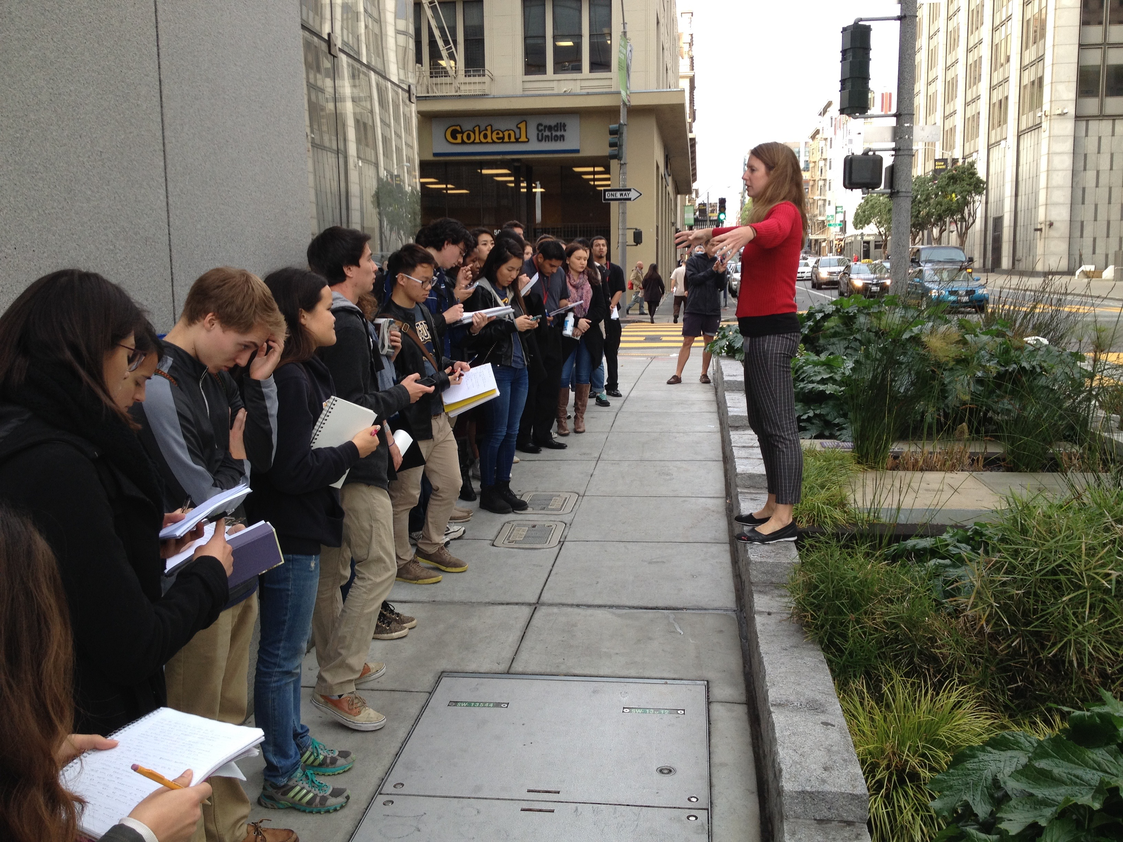
Field trip to the ‘Living Machine’ at San Francisco PUC headquarters

