Slide 1
Gaming the System: Students Engage Creatively to Learn Concepts
Waves of Innovation: Student Engagement Strategies
Claire Kremen
ESPM, ckremen@berkeley.edu

Slide 2


Active Learning Requires Student Buy-in
Use games to encourage buy-in
1. First day of class
Poll learning goals
  1. Acquiring information
  2. Learning how to use information and knowledge in new situations
  3. Developing lifelong learning skills
Discuss how AL promotes learning goals
Based on Gary Smith, National Teaching and Learning Forum, 2008
Notes:
I use games to increase student buy-in to active learning, and I do this in 3 ways, within the first 2 weeks of class.
Most people in the class want 2 (or 3)
National Teaching and Learning Forum, Volume 17, #5, Sept 2008

Slide 3

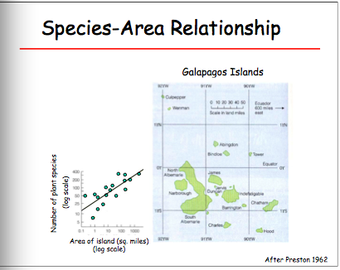
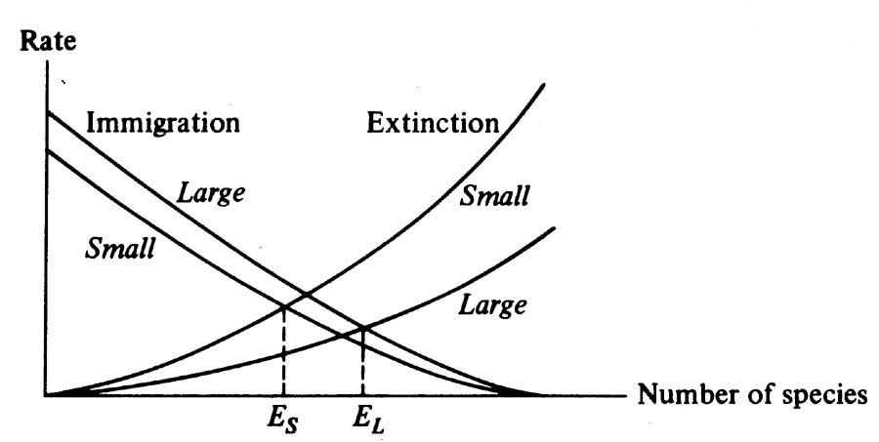
2. 2nd Class – Island Biogeography theory
The Prompt:
You are working for a company that designs fun, educational games.
Working in teams of five, your job is to design a board game that illustrates the principles of island biogeography theory that lead to the species area effect.
First, identify the key processes that need to be illustrated (i.e., colonization)
Then develop your game ideas. (~10 min)
Notes:
First I give 20 min lecture on Island Biogeography Theory – observations that stimulated the theory, and the theory itself
Then I remind them of their educational goals, and how playing kerbal space games helps Nasa employees to gain skills
Then, they get to design a game to illustrate IBT principles, in small groups.

Slide 4
Your company loves brainstorming. They frequently assemble multiple teams to approach the same design challenge. Then different teams get together to assess each others work.
Join with another group.
Each group should first describe their game and then obtain feedback (constructive criticism please!) from the other group.
After both teams have presented and exchanged, each person fills out an assessment sheet about the other groups’ game, to share.
(~18 min → 3 min/team to present, 3 min/team feedback, 3 min – assessment sheets, 3 min sharing)
Notes:
1/21/16: In this case since we ran out of time we had them turn in their assessment sheets, and we are scanning them and allowing each group to view their assessments on line.

Slide 5
3. 2nd WEEK of CLASS
Landscape ecology of patch-dependent species
SEQUENCE
In class (10 min): brainstorm initial idea
Section that week:
30 min to refine game
5 min each to present
7 min feedback on each game
Section following week:
Refine game, begin write up
Group write-up due following week
Scenario. Parks & Rec – voting on landscape plan.
Design a game (board, app, video, cooperative, or athletic…) that illustrates the response of patch-dependent species to the matrix as described by Driscoll et al. 2013 (Fig 2).
Your game must illustrate the three core concepts and at least two of the dimensions. (Extra credit for more dimensions!)
In this session – don’t get locked in – use it for brainstorming. Think carefully about the concepts you want to illustrate. How do you communicate with these smart but bureaucratic adults? What sort of game might work best?
Notes:
2nd week of class – introduce a much more complex concept: Landscape ecology of patch-dependent species
They read the paper describing this model, by Driscoll et al., and answer some questions on it before coming to class.
Game in class.
Time in and outside of class to do it. Have fun with it, and get creative. Games are a great way to learn and to teach. But just in case you are wondering, this will be the last time that we use a game in class – after this, we’ll move on to other kinds of activities.
Scenario:
Imagine the show “Parks and Rec”. We have to convey to a group of smart adults these patch-matrix processes. But these are bureaucrats that really don’t understand the biology. Once they learn these concepts they are going to vote on a landscape plan. There are several plans for them to vote on. But they are not going to understand how to differentiate among these landscape plans unless they learn these patch matrix concepts and that is the goal of your game.
Design a game that illustrates the response of patch-dependent species to the matrix as described by Driscoll et al. 2013 (Fig 2). Your game must illustrate the three core concepts and at least two of the dimensions. You could develop a concept for a board game, a game that uses people as the players, an app, a video game, etc. It could be a cooperative game, or a game in which one player is pitted against another. Use your creativity and have fun with it!
Most Important – not as many bells and whistles – but make sure the game really describes the processes that Driscoll is talking about.

Slide 6
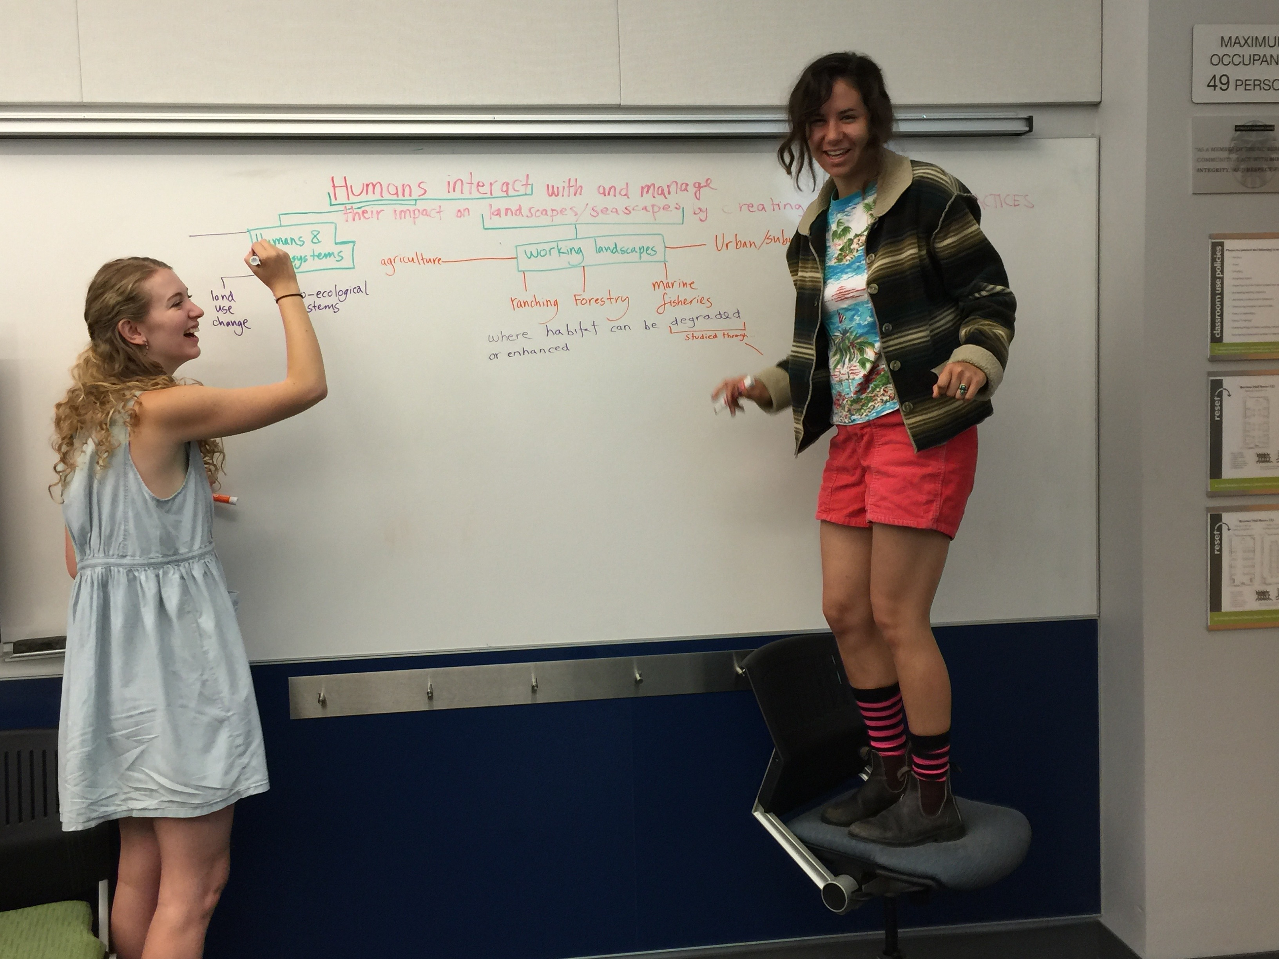
SUBjective observations
Students are highly animated, engaged in game development
Games appear to be great learning tools – students illustrate concepts well, demonstrating understanding
Students refer to the concepts learned through these games throughout the rest of the semester
Students have fun, and get to know each other, which may enhance their willingness to participate in other forms of active learning.
Importantly, the three activities with games are all in the first two weeks of class. Then we move on to other types of student engagement.

