Slide 1
Digital Reading:
What do we “know”?
Michael Larkin, College Writing Programs
“Young people, who vote with their feet in college, are marching in…the digital direction….To reach them, we must start close to where they are, rather than where we imagine or hope they might be.”
--N. Katherine Hayles (2010)
http://writing.berkeley.edu/resource/digital-reading-challenges-and-opportunities

Slide 2
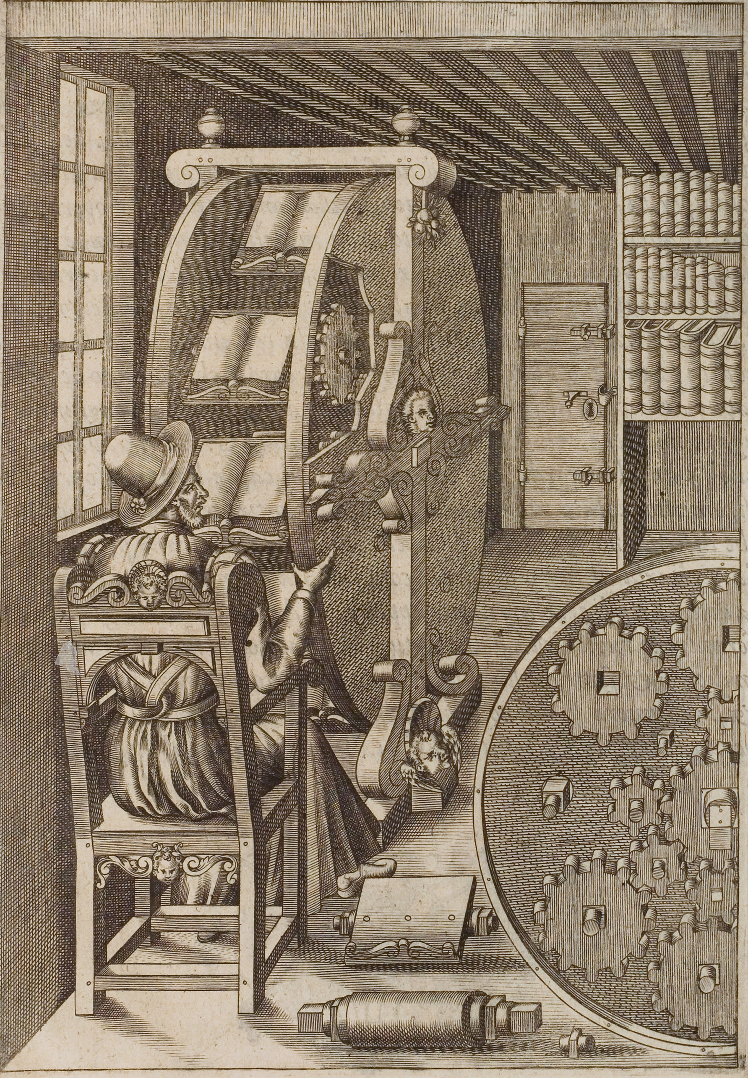
Digital Reading:
Where do we go #next?
http://writing.berkeley.edu/resource/digital-reading-challenges-and-opportunities

Slide 3
Digital Reading: Where do we go #next?
Why are you staring at this screen for answers?
*Point one (You are…)
*Point two (…getting…)
*Point three (…very sleepy.)
Be mindful of how you and your students read
http://writing.berkeley.edu/resource/digital-reading-challenges-and-opportunities

