Slide 1
Tumblr & a Framework of Rigorous Play: Digital Interventions for Multilingual Students
Ryan Sloan
University of California, Berkeley
http://sloanstudio.tumblr.com

Slide 2
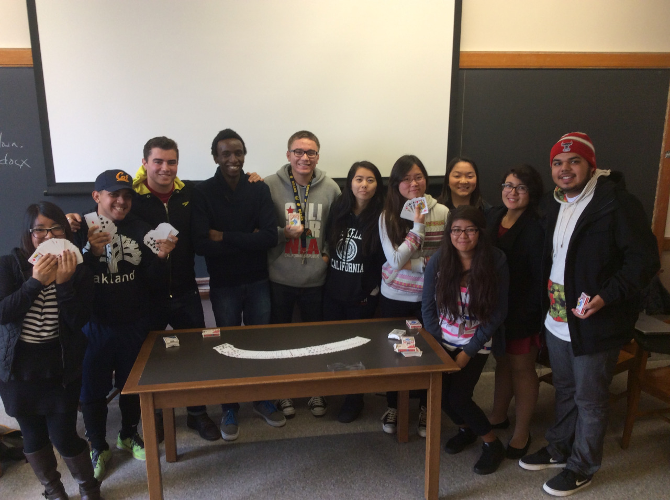
Problem: Student anxiety -- final product over iterative process
Opportunity: How can the structured use of multimodal tools like Tumblr help to reduce the affective filter and improve critical reading, writing, & thinking skills?
Context:
Reconceiving of digital workspace as an Artist’s Studio -- creative clutter & centrality
Notes:
At U.C. Berkeley’s College Writing Programs, I work with an incredibly diverse group of learners, from multilingual bridge summer students to an accelerated first-year composition group to advanced undergraduate researchers. Given the especially large number of multilingual and Generation 1.5 learners, as well as high anxiety in general around ‘perfect’ writing, the Tumblr space is intentionally messy, interactive, and dynamic.

Slide 3
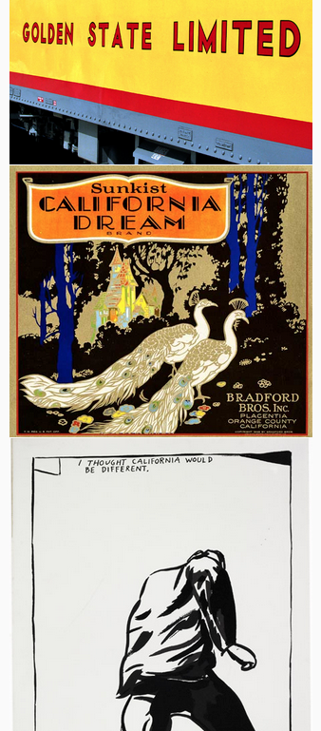
Framework of Rigorous Play:
cumulative, recursive & interlocking framework
honors World Englishes
teaches strategies of discourse negotiation & the principle of 'rigorous play'
Execution:
-bDrive: student-led analytical forums between classes
-Google Docs: peer & instructor feedback, metacognitive loop
-Tumblr: simple, potentially rich space for ideation, semi-public writing & thinking
Notes:
Value of the ‘pedagogy of abundance’ (Weller 2011) and the importance of self-regulated learning:
goal-directed / independent access
a willingness to access, explore & contribute
metacognitive iteration
A cumulative, recursive, and interlocking framework (Matsuda 2010) that honors World Englishes while teaching the strategies of discourse negotiation and the principle of 'rigorous play'.

Slide 4
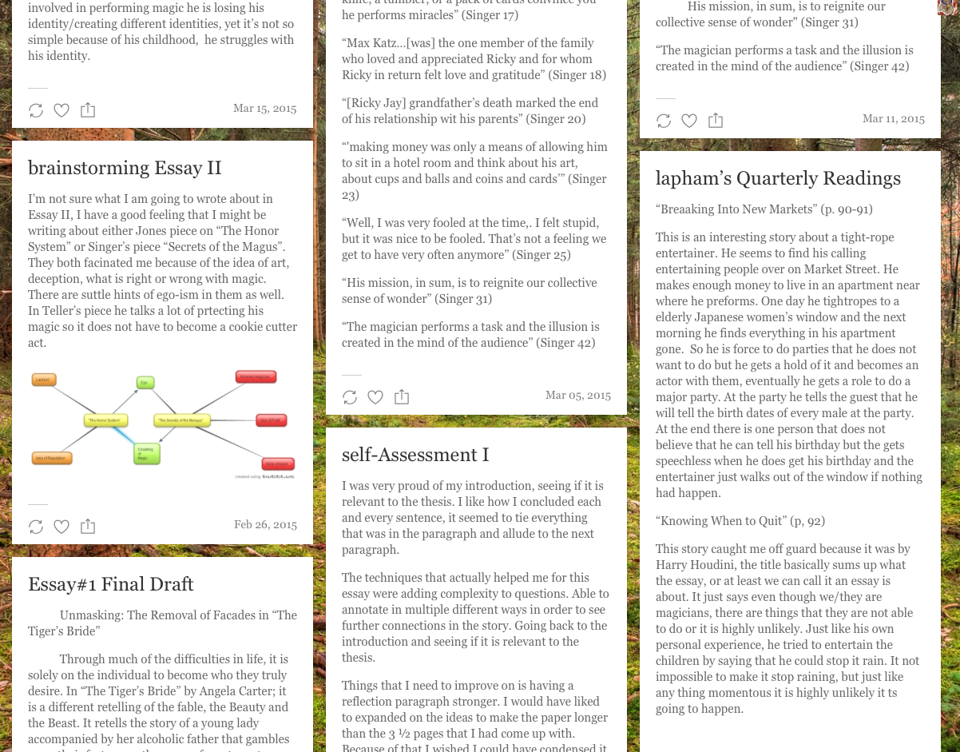
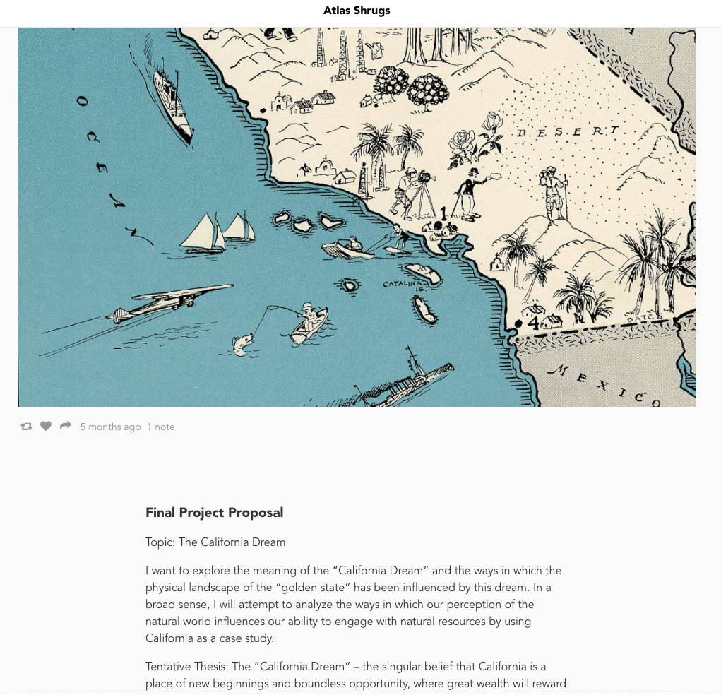
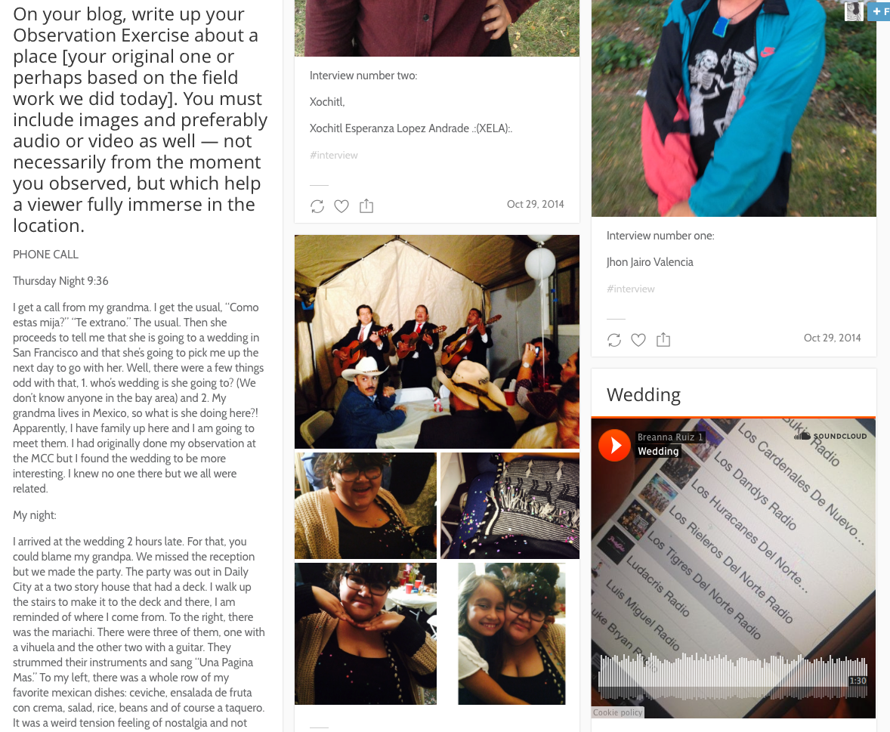
Findings:
When focused on semi-public nature of final drafts, students keep rhetorical audience in mind
The affective filter gradually lowers for learners suffering from anxiety over the creation of ‘perfect’ work
Students often do more writing and more work, as they seek out additional evidence (images, video, audio, links, passages)
Quality of the brainstorming / drafting posts: generally rough syntax & grammar but more freely engaged
Notes:
Student Findings:
“Posting my writing and ideas onto the Tumblr blog was very useful and different. It allowed me to save my work in one area, but also to express my ideas in a different way. It removed the anxieties of writing.”
“I used tumblr as much as I could to post ideas, thoughts and it helped keep everything organized with easy access.”
“Really helpful… much easier to follow the coursework simply due to the informality.”
“I recommend students take advantage of the multimodal writing blog created at the beginning of the semester, and post all their work online, as it illustrates one’s progress through the entire course.”
“The blog was an organizational and creative space instead of just a place to turn in assignments.”
For more, please visit http://sloanstudio.tumblr.com

