Slide 1
“Nose-Ring” assignments.
Using bCourses modules to implement scaffolded online assignments in a synchronous online course.
Dan Acland.
Goldman School of Public Policy.

Slide 3
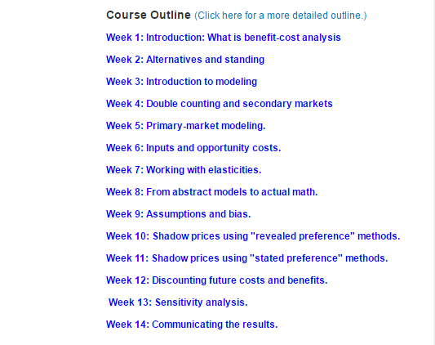

Slide 6
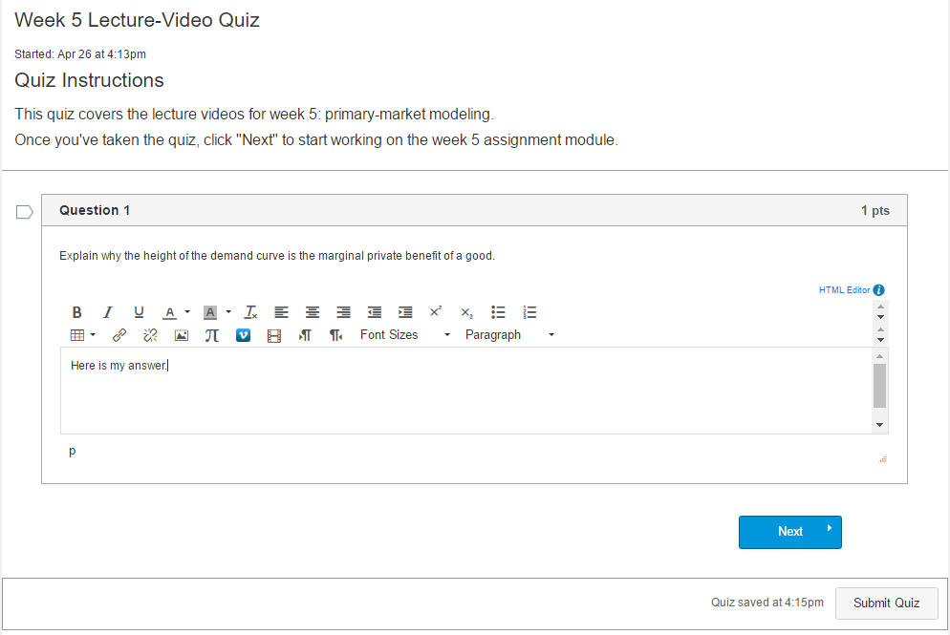

Slide 7
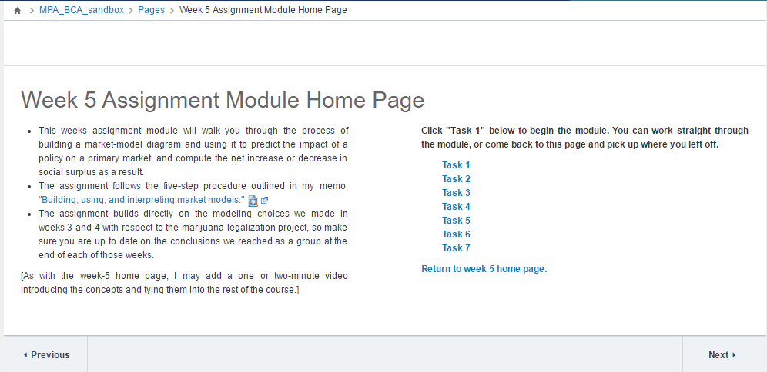

Slide 8
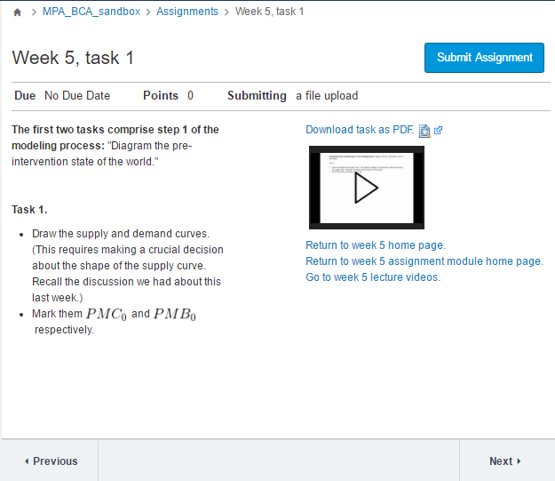

Slide 12
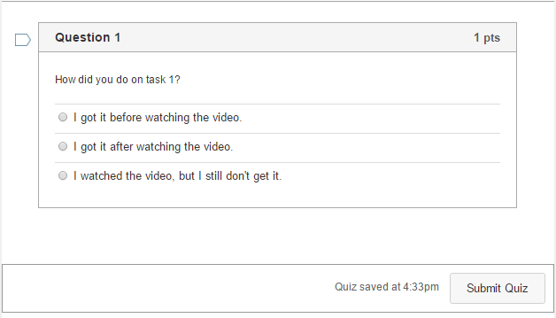

Slide 13
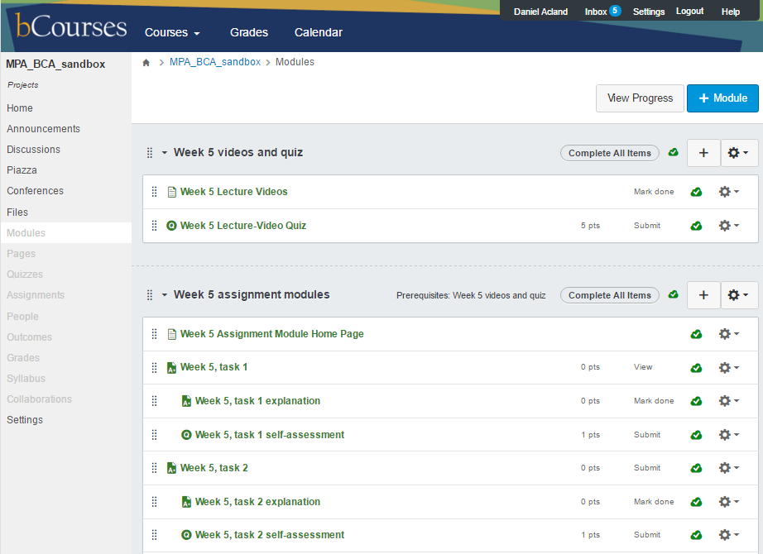

Slide 14
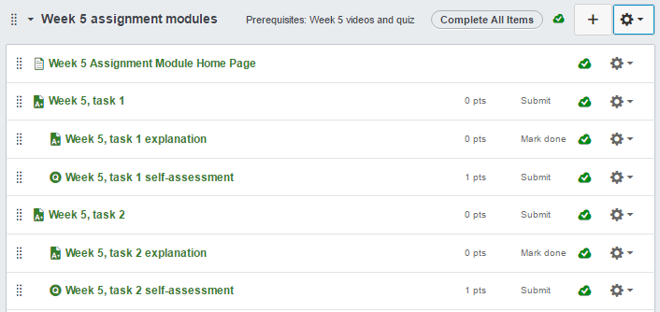

Slide 15
Thank you.

