Slide 1
Using peer to peer feedback for learning and engagement
Claire Kremen
ESPM
Dialogues Series, 2/13/17
Notes:
I use peer to peer feedback in many ways in my class, with the goal of encouraging engagement, and encouraging learning. But, I hasten to say that I am no pedagogical expert. My remarks are just to give some examples that may be interesting to you, and to get the conversation going. I’m going to quickly describe 5 examples.

Slide 2
Example 1. Creating games to develop deep conceptual learning
Landscape ecology of patch-dependent species
Notes:
Students in my class read a key paper that describes a complex conceptual model. Some of the complexity (but not all) is displayed here. We talk about the paper in detail in class. Then, I ask them in groups to develop a game that illustrates the core effects and 2 or more of the modifying dimensions. The goal is to use the game to explain to Parks and Recs bureaucrats (from the Parks and Rec series) what would be the consequences of different land management strategies on threatened and endangered speciesX

Slide 3
Example 1. Creating games to develop deep conceptual learning
PEER FEEDBACK FORM
1. This game was helpful for understanding which of the three core effects and 5 modifying dimensions (circle):
<LIST>
2. What part/aspect of the game did you find the most effective for helping you understand one of the core effects or dimensions?
3. Which of the core concepts or dimensions do you think would benefit from additional explanation/development? How? What would you change to make the game more fun/engaging?
4. How understandable are the rules of the game? Do you think you would be able to play the game given these instructions? What rule(s) or aspect(s) do you think most need(s) to be clarified?
5. Would you be interested in playing this game? Briefly, why or why not?
LEARNING: 1. developing the game; 2. providing feedback to others on their game; 3: revising their own game in response to feedback and writing about it
Notes:
After they develop the game, they present it to another group and each member of the group fills out a feedback sheet on the game and also gives verbal feedback….the students use this feedback in revising their game, and when they turn in their write up to us they must also say specifically what feedback they got and how they incorporated it.
Developing the game, and then giving feedback to other groups, plus revising in response to the feedback they receive, means they really, really learn this conceptual model by the time they are done.

Slide 4
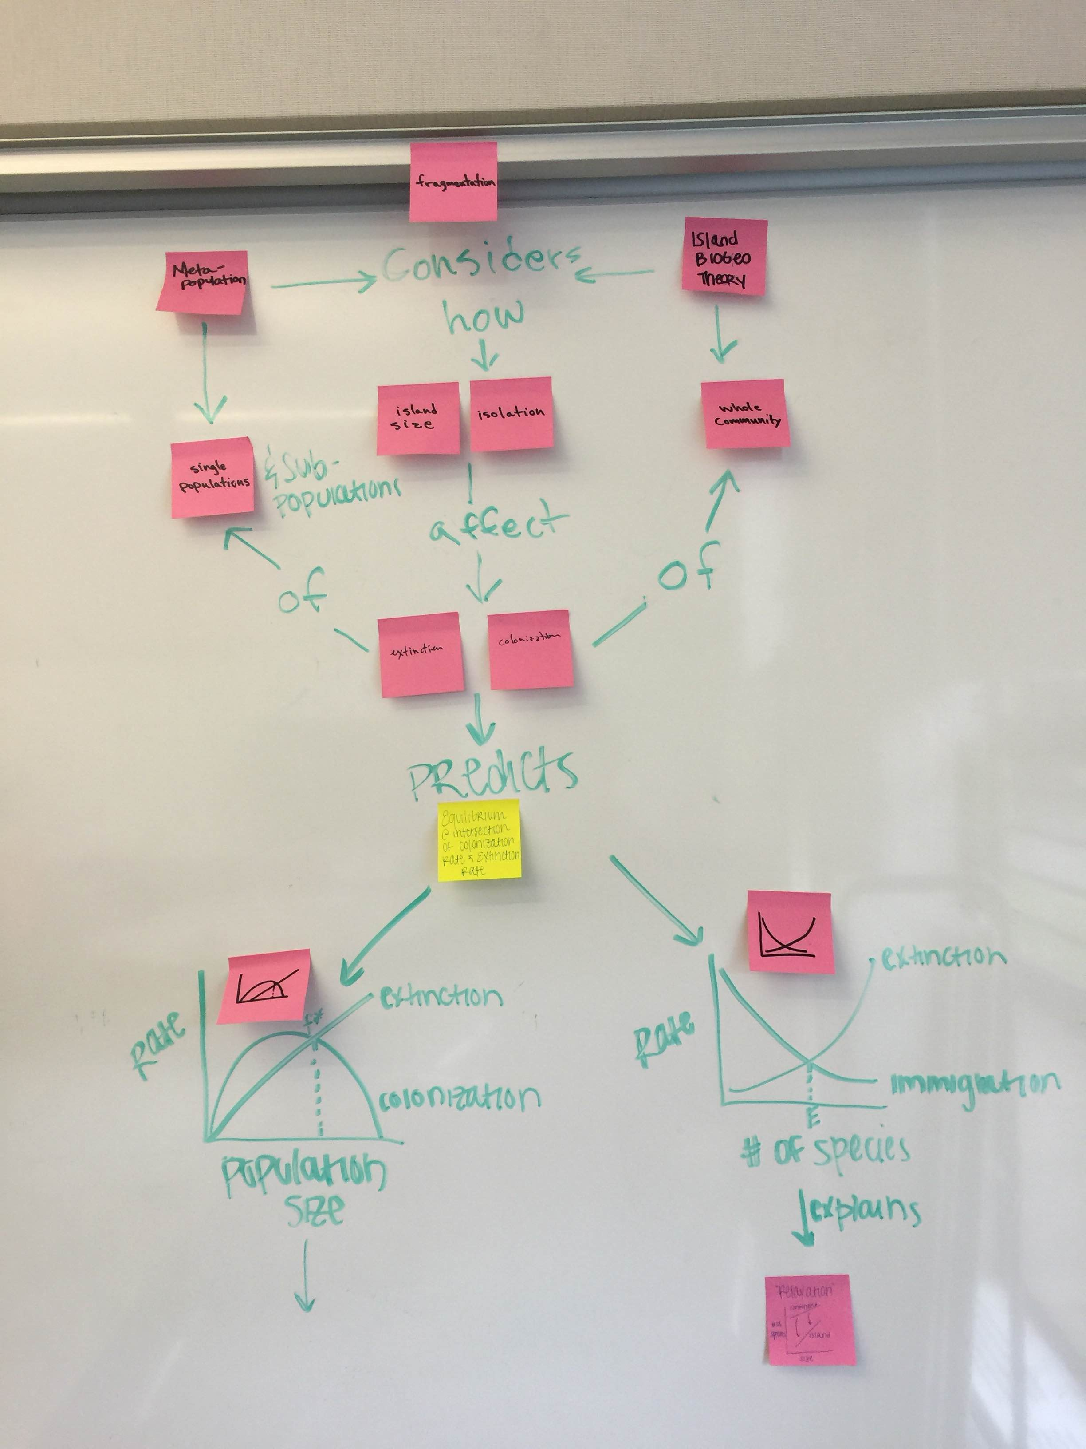
Example 2. Low stakes voting
Develop a concept map that explains the relationship between two central theories in conservation biology – island biogeography theory and metapopulation theory.
Notes:
They do this in groups and its not an easy exercise. They come up with their concept maps and then they walk around to all 6 maps, and vote on the one that they think is most effective. Many of them end up very messy with too many details and lacking in clarity. Invariably they do NOT vote on their own – they pick the one that is clear and to the point…which provides me with an opportunity to make the point that sometimes less is more, and that the point of concept mapping is to portray the essence of the issue. Its low stakes as there is nothing at stake for them but their pride...and because they themselves select the winning one (and its generally a landslide for one image) there is buy-in from the class. They also always pick the one that I would have picked...

Slide 5
Example 3. Final project writing assignment – “Arts and Crafts”
Many points of peer review – initial idea, outline, abstract
First full draft – bring a print-out to section
CUT UP INTO SEPARATE PARAGRAPHS AND SHUFFLE!
Partner then reads all the pieces and reassembles into the order they think is most logical.
Reference: not my original idea but I could not find the reference!
How we know that all of this peer review helps…..
Notes:
Excruciating for the students – they hate it.
But…if the peer orders it the same way as the original – they get confirmation that their order made sense.
And...if its totally different, it may shed light on what isn’t working, or perhaps provide a much better organizational structure that the reader really needs.
How we know all of this peer review helps....the papers are so, so much better than papers I’ve ever gotten from a class before where i did not do peer review. They are actually a pleasure to read!

Slide 6
Example 4. Speed talks of final projects
Skill development on how to give a speed (3 – 4 min) talk
Final projects are in 4 categories: Research Review, Debate, Research Proposal, Case Study
How to engage the listeners? They are given tasks:
  Research reviews and debates: Listeners work in groups to summarize each presentation with two sentences and a question -- give to presenter providing them with feedback
  Research proposals: Listeners form a panel of judges that must decide how to allocate a pot of funds
  Case studies: World Café format
Notes:
Requiring the listeners to take an active role ensures that the audience will be engaged, that the listeners will learns something from the presentations, and that some form of indirect feedback is coming back to the presenters. Did the audience understand my talk? Was I convincing? Are they asking good questions?

Slide 7
Example 5. Self-evaluation / peer evaluation of role in group project
Graduate class; projects commissioned by conservation NGOs
Feedback Form: Briefly enumerate the project deliverables that your group decided on, and evaluate at what level each was met (fully, partially, not at all).
Briefly describe who did what in your group project, including your own role.
Evaluate your contributions to the group project. What key work did you accomplish in developing the deliverable(s) for your groups’ project?
What were your personal goals in conducting your portion of the group project? Did you meet these goals? Why or why not? Consider what you could have improved, and what limiting factors may have existed outside of your control.

Slide 8
To use peer evaluation in grading
Michael O’Hare
http://teaching.berkeley.edu/news/peer-evaluation-class-participation

