Slide 1
VISUAL & SPATIAL CREATIVE ACTIVITIES FOR RESEARCH READING AND WRITING
Patina K. Mendez¹ & Teri E. Crisp²
¹ Environmental Science, Policy & Management
² College Writing Programs

Slide 2
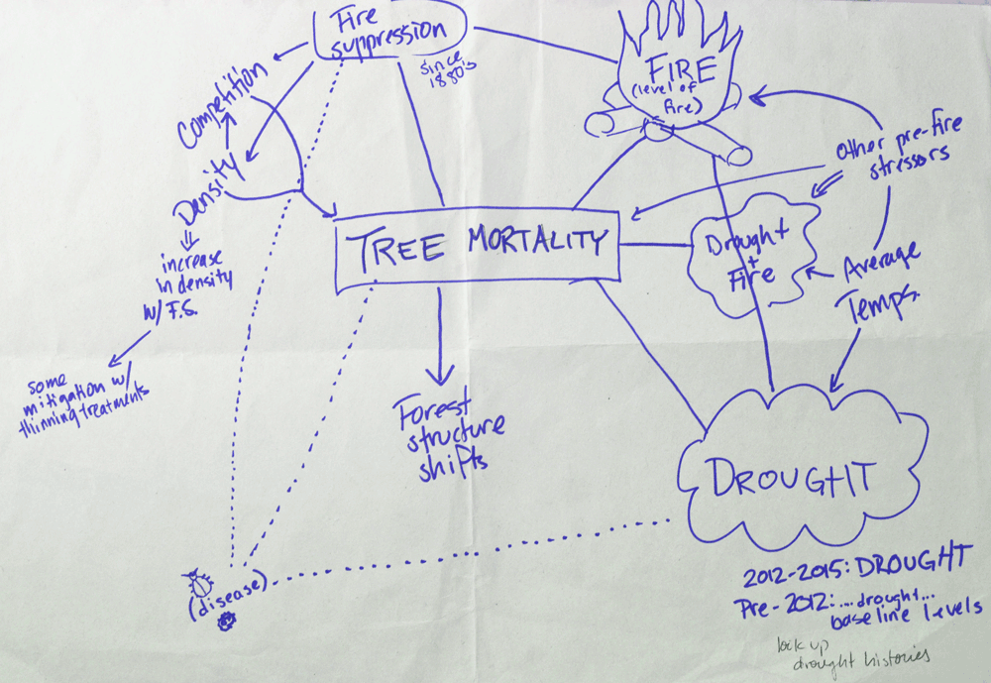
Reading and writing are visuospatial processes that build and use mental maps for recall, analysis and composition.

Slide 3
Source
Material
Organizing information
Source materials may be long and complex or short and dense
Students may not understand intent and argument of author
Not all source materials are relevant to the student’s research topic
Digital reading limits annotation and tactile interaction
Students may miss relevant evidence within digital and print sources
Must interpret and sort supporting and contrasting evidence
Often have difficulty organizing argument and visualizing the final form of the manuscript
Digital composition limits experimentation with organization

Slide 4
Understanding Source material

Slide 5
Organizing information

