Slide 1
Technical Depth:
BIOE, CEE, EECS, IOER, ME, MSE, NE
Capstone Project
Instant class feedback
Diverse student body
Capstone Integration
Presentations
Individual reflection on video
Leadership:
Tech Strategy, IP, Ethics, Finance, OB, Marketing, etc.
Team feedback on video

Slide 2
CURRICULUM & QUESTIONS
187 STUDENTS
49 TEAMS
6 PRESENTATIONS
118
KEY QUESTIONS
Best practices?
Structured vs. unstructured reflection?
Open-ended
CONTROL
67
360 VIDEOS
1600 VIEWS
Facilitated
5 individual goals
6 team goals
Use of a time-index
EXPERIMENT

Slide 3
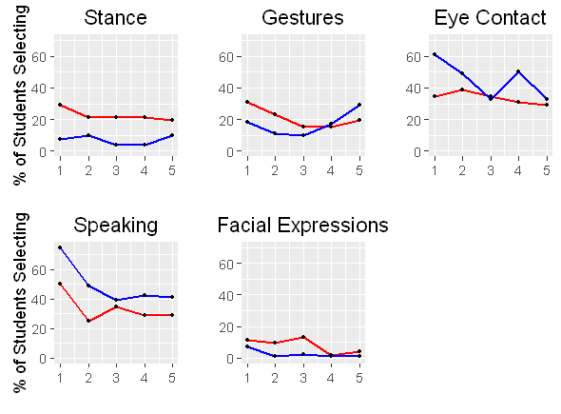
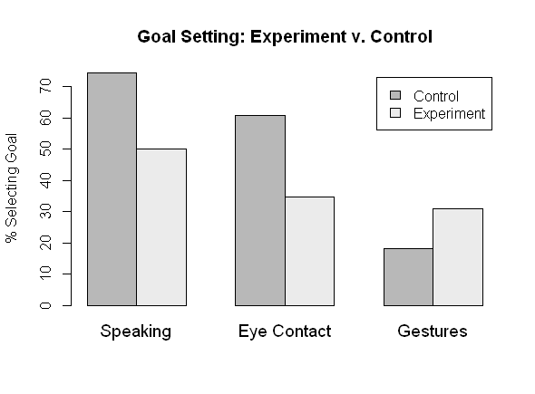
OUTCOMES & GOALS
PRELIMINARY RESULTS
NEXT STEPS
Re-score videos
Goal selection <-> improvement
Compare between facilitated and open-ended groups

